Slide 1


AI
for climate change
Machine Learning for UN SDG 13: Climate Action
Presented by: Group no 63
Course: AI for Software Engineering | PLP Academy

Slide 2


🌍 The Problem:
Climate Change is Escalating
Rising Emissions
Lack of Forecasting
Carbon emissions are increasing yearly, driven by industrial activity, energy usage, and deforestation.
Without accurate emission predictions, governments and organizations can’t take proactive climate action.
Regional Data Gaps
Delayed Policy Response
Many developing regions lack detailed emissions data, limiting their ability to make informed sustainability decisions.
Climate action is often reactive, not preventive, due to slow or unreliable environmental data insights.

Slide 3
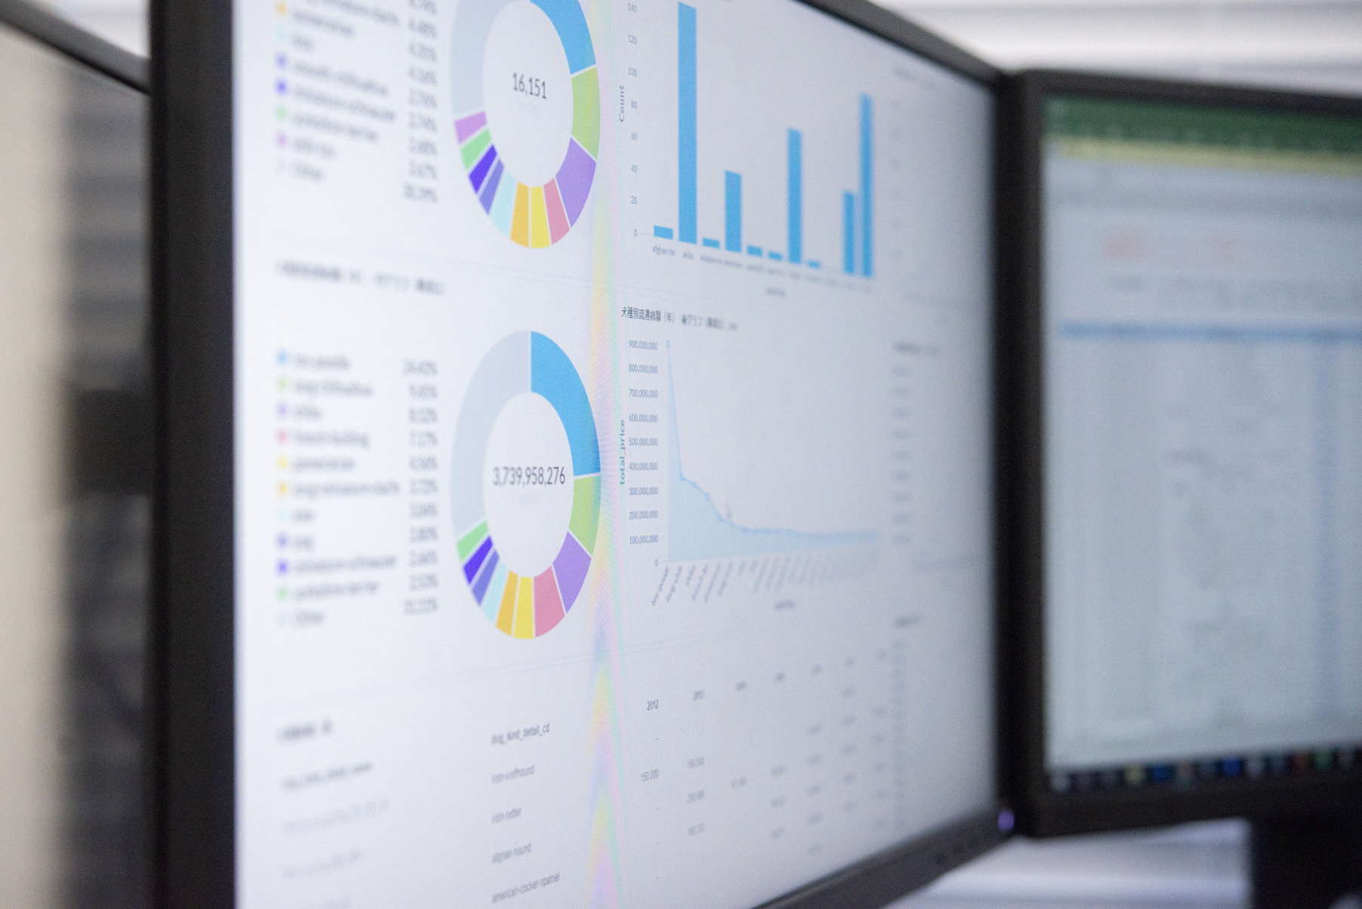




🌱 Our AI-Powered Climate Solution:
Forecasting Emissions for a Greener Future
1. Data Collection
Use open datasets from sources like the UN, World Bank, and Kaggle that contain carbon emission records across regions.
2. Model Training
Train a regression model (like Random Forest or Linear Regression) on historical emission trends to forecast future carbon output.
3. Prediction & Visualization
Use real-time or test inputs to predict CO₂ levels. Visualize the results in graphs or maps to show where emissions will spike.
4. Climate Impact Insight
These forecasts help policy makers and organizations take proactive steps—reducing emissions before they peak.

Slide 4
Artificial Intelligence:
🧠 Our AI Approach & Ethical Reflection
Supervised Learning
Model Evaluation
We used a regression-based supervised learning model (Random Forest) to predict carbon emissions using historical data.
Performance was evaluated using metrics like MAE (Mean Absolute Error) and R² score to ensure reliability and accuracy.
Feature Selection
Ethical Considerations
Key features include industrial activity, population, energy use, and regional emission data—sourced from trusted datasets.
Bias in datasets can impact fairness. Our model was tested across regions to reduce inequity and support global climate justice.

Slide 5
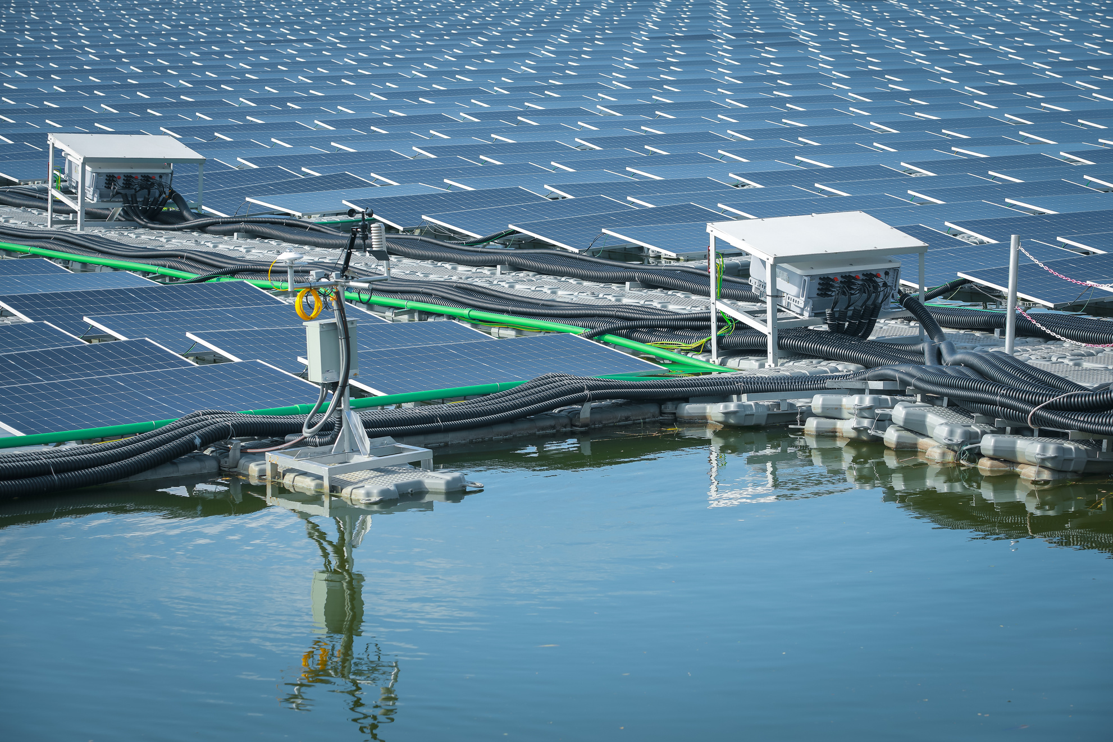
🌍 AI for Climate Action
📈 Predicting Carbon Emissions for a Sustainable Future
Problem Statement
Carbon emissions forecasting is critical for planning sustainable policies and mitigating climate change.
AI Solution
We used supervised learning (Random Forest Regression) to predict future CO₂ levels based on industrial, energy, and demographic indicators.
Impact
Our model helps policymakers and environmentalists assess hotspots and simulate greener energy alternatives.
Real-World Application
Governments can use such AI models to shape climate strategies, enforce emission limits, and align with SDG 13 targets.

Slide 6

Evaluating AI Performance
Accuracy, Insights, and Impact
Model Accuracy
Policy Relevance
🎯 Achieved R² Score of 0.91 and RMSE of 1.7 ppm, indicating strong predictive performance on CO₂ levels.
🏛️ Our results support data-driven climate policy, allowing simulations of cleaner energy transitions and regional emission control.
Visual Insight
📈 Forecast graphs revealed a potential 20% rise in emissions by 2035 under current trends — emphasizing the urgency for intervention.
Key Features Identified
User-Friendly Dashboard
📌 Energy use, industrial output, and urban population emerged as the top predictors of emissions.
🧭 Model output can be integrated into an interactive dashboard for real-time scenario testing by stakeholders.

Slide 7

Responsible AI
for a Greener Future
Data Bias Mitigation
🌍 Normalized data to reduce bias from underrepresented regions.
Equitable Access
🌐 Promotes AI accessibility for developing nations to support climate efforts.
Transparent Decision-Making
📊 Enables evidence-based policymaking grounded in explainable AI results.
Long-Term Sustainability
🌱 Ensures models are not just accurate but ethically aligned with SDG 13 goals.

Slide 8

The Impact of Technology;
Join Us in Climate Innovation
AI for a Better Planet
🤖🌍 AI is a powerful ally in the fight against climate change.
What This Project Proves
📈 Our model shows how machine learning enables proactive climate action.
Collaborate for Impact
💡 Let’s build smarter, cleaner, and more sustainable systems—together.

Slide 9

Thank You! Let’s Connect 🤝
“Together, we can build an AI-powered, climate-resilient world.
Let’s take data-driven action for a greener tomorrow.”

